Slide 1
Healthiest Lifestyles per City
By Kimberly Cable
June 4, 2022
DSC 530: Data Exploration and Analysis
Bellevue University

Slide 2
Introduction
This study looks at the top healthiest cities and tries to determine what makes them healthy. Specifically, it looks at obesity levels, levels of sunshine each city gets, the cost of a bottle of water, the number of outdoor activities each city has, the average number of hours a person works, pollution, and life expectancy.

Slide 3
Variables Used for Analysis
SunshinePerDay: The average number of hours of sunshine a city gets
obesity_levels: Levels of obesity per country
water_cost: The accost of a bottle of water per city
outdoor_activity: The number of outdoor activities a city has
WorkPerDay: The average number of hours individuals work per day in each city
pollution: The pollution index score per city
life_expectancy: The life expectancy in years per country.

Slide 4
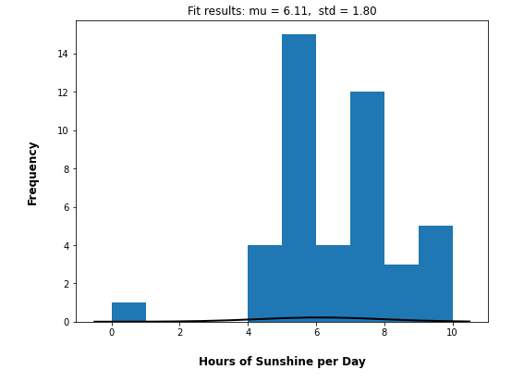
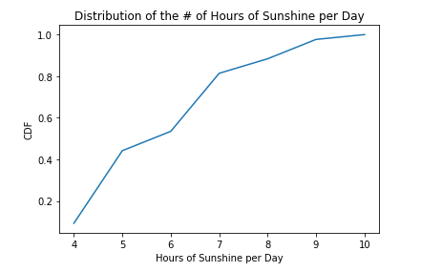
Analysis: Number of hours of Sunshine per Day per City
Summary Statistics:
Outliers: 2 at 0 and 10 hrs
Mean: | 6.11
Median: | 6
Mode: | 5
Spread: | 0 hrs – 10 hrs
Std Deviation: | 1.82 hrs
Skew: | -0.42
Since a city rarely has 0 hrs of sunshine, we can safely remove those cities.
Cities with 10 hrs of sunshine can happen so those cities will remain
The CDF indicates that 50% of healthy cities have 6 hours of sunshine per day.

Slide 5
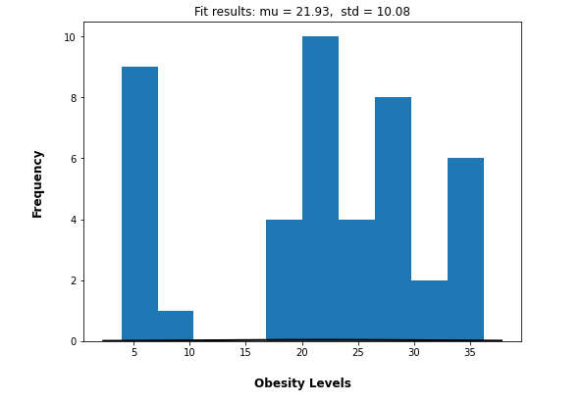
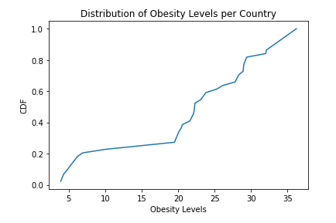
Analysis: Obesity Levels per Country
Summary Statistics:
Outliers: 4 outliers from levels 3.9 – 4.7
Mean: | 21.93
Median: | 22.3
Mode: | 36.2
Spread: | 3.9 – 36.2
Std Deviation: | 10.20
Skew: | -0.47
The levels seem to be far from the mean so we can safely remove them but there can be cities with very low obesity levels so keeping them wouldn’t be out of the question
The CDF indicates that 50% of the people in healthy cities have obesity levels of 22.3 and below.

Slide 6
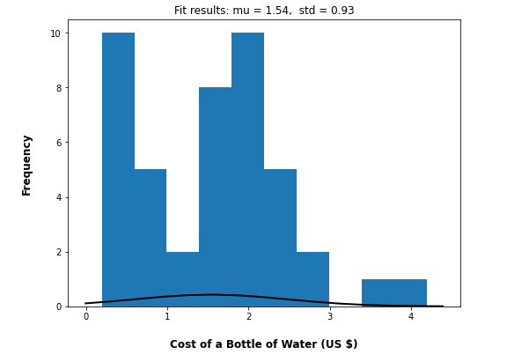
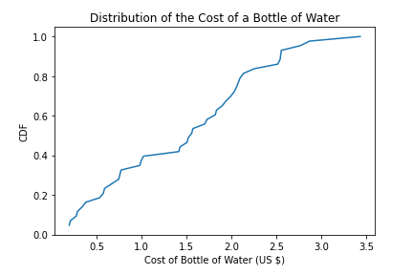
Analysis: Cost of a Bottle of Water (US $)
Summary Statistics:
Outliers: 1 at $ 4.19
Mean: | 1.53
Median: | 1.57
Mode: | 0.19
Spread: | 0.20 – 4.19
Std Deviation: | 0.94
Skew: | 0.46
There is one outlier of $4.19 for a bottle of water. Since the mean is $1.52 I this we can be safe to remove this outlier and just a very expensive city
The CDF indicates that 50% of healthy cities have a bottle of water that costs $1.56 or less.

Slide 7
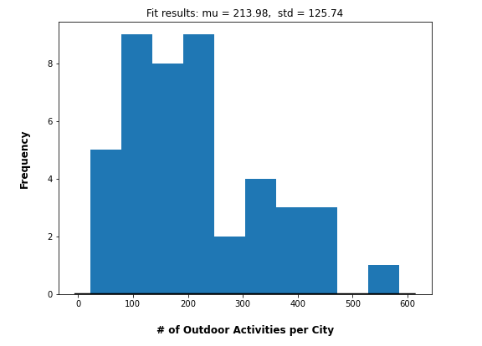
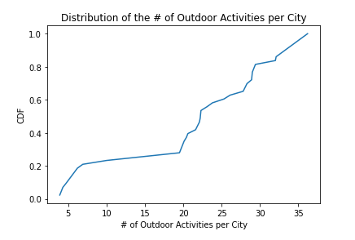
Analysis: Outdoor Activities per City
Summary Statistics:
Outliers: 1 at 585 activities
Mean: | 213.98
Median: | 189.5
Mode: | 223
Spread: | 23.0 - 585
Std Deviation: | 127.19
Skew: | 0.79
There is 1 outlier having a whopping 585 outdoor activities. As the mean is 214, I think we can safely remove this one city
The CDF indicates that 50% of healthy cities have at most 187 outdoor activities.

Slide 8
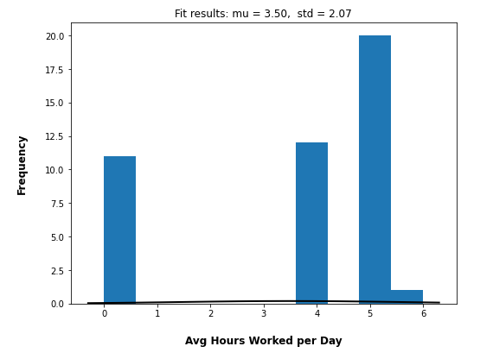
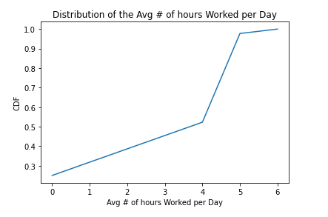
Analysis: Average # of Hours Worked per Day
Summary Statistics:
Outliers: 11 at 0 hrs
Mean: | 3.5
Median: | 4.0
Mode: | 5.0
Spread: | 0 - 6
Std Deviation: | 2.10
Skew: | -1.02
A lot of the cities has 0 daily hours of work but since this is an average this needs to stay in the dataset
The CDF indicates that 50% of the people in healthy cities work under 4 hours per day.

Slide 9
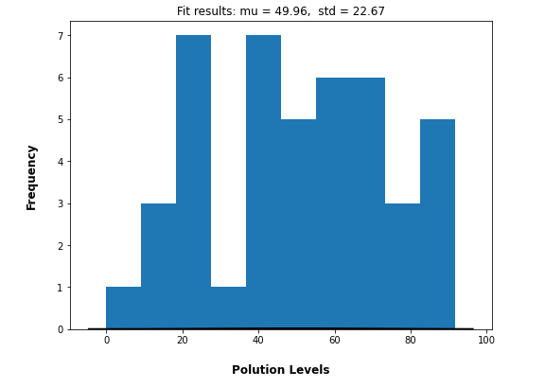
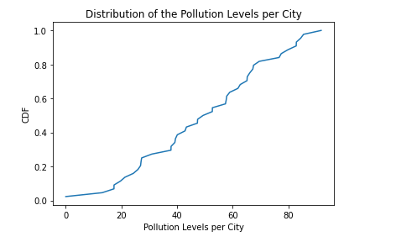
Analysis: Pollution Index Score per City
Summary Statistics:
Outliers: none
Mean: | 49.96
Median: | 50.98
Mode:
Spread: | – 91.74
Std Deviation: | 22.93
Skew: | -0.10
The CDF indicates that 50% of healthy cities have pollution levels below 49.32.

Slide 10
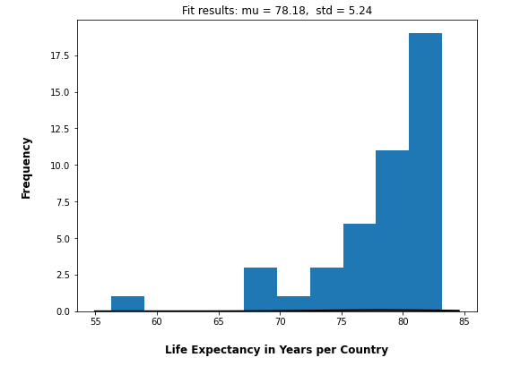
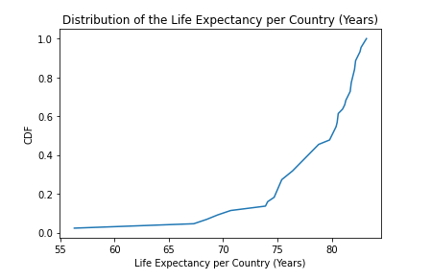
Analysis: Life Expectancy in Years per Country
Summary Statistics:
Outliers: 1 at 56.3 years
Mean: | 78.18
Median: | 80.4
Mode: | 78.8
Spread: | 56.3 – 83.2
Std Deviation: | 5.30
Skew: | -2.10
With life expectancy, I think we should keep this as the country may not live as long as others.
The CDF indicates that 50% of the people in healthy cities live to a maximum age of 80.4 years old.

Slide 11
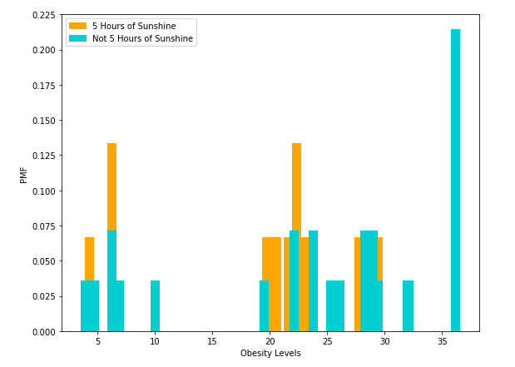
Compare Obesity Levels to the Average Number of Hours of Sunshine per Day per City
Mean obesity level with 5 hours of sunshine: 19.07
Mean obesity level with the rest: 23.54
As you can see, with the mode of 5 hours of sunshine, the obesity level is lower than the rest.

Slide 12
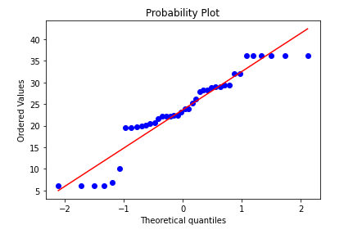
Probability Plot: Obesity Levels
The probability plot suggests that the distribution of Obesity weights shows levels near a normal distribution. The lower and upper levels or more skewed than the others

Slide 13
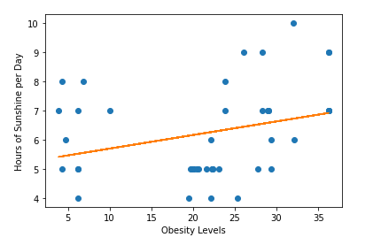
Obesity Levels vs Number of Hours of Sunshine per Day
The scatterplot shows that there is a weak positive correlation between obesity levels and the number of hours of sunshine per day. A low Pearson’s coefficient and R-squared also indicate this
Pearson’s Correlation:
Correlation = 0.40
p-value = 0.001
R-squared: 0.09

Slide 14
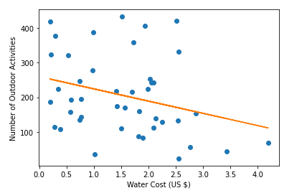
Water Cost (US $) vs Number of Outdoor Activities
The scatterplot shows that there is a weak negative correlation between the cost of a bottle of water and the number of outdoor activities a city has. The Pearson’s coefficient and R-squared indicate this too.
Pearson’s Correlation:
Correlation = -0.29
p-value = 0.056
R-squared: 0.09

Slide 15
Summary Statistics:
Hypothesis Test:
Obesity Levels/ Hours of Sunshine | Count | Mean | Std | Min | 25% | 50% | 75% | Max
5 Hours | 15 | 19.07 | 7.52 | 4.3 | 19.8 | 20.6 | 22.3 | 29.4
Rest | 28 | 23.54 | 11.35 | 3.9 | 17.13 | 27.2 | 32.03 | 36.2
H₀: Distributions between obesity levels for 5 hours of sunshine and rest are the same
H₁: Distributions between obesity levels for 5 hours of sunshine and rest are different
Student’s t-test
ANOVA
t-statistic: -1.38
p-value: 0.18
t-statistic: -1.38
p-value: 0.18
The p-values indicate that the significance is low so we can reject the null hypothesis that obesity levels between 5 hours of sunshine and the rest are the same and accept that they are different.

Slide 16
obesity_level | WorkPerDay | SunshinePerDay | water_cost | outdoor_activity | pollution | life_expectancy | life_expectancy2 | R² ^{(Adj R2)}
Model 1 | 2.32 (0.001) | - | - | - | - | - | - | 0.227 (0.21)
Model 2 | - | 1.58 (0.71) | - | - | - | - | - | 0.055 (0.06)
Model 3 | - | - | 4.13 (0.024) | - | - | - | - | 0.118 (010)
Model 4 | - | - | - | 0.01 (0.35) | - | - | - | 0.021 (-0.003)
Model 5 | 2.71 (0.003) | 1.95 (0.015 | 6.49 (0.004) | 0.01 (0.297) | 0.05 (0.525) | -0.84 (0.023) | - | 0.51 (0.425)
Model 6 | 3.07 (0.001) | 2.11 (0.006) | 7.82 (0.001) | 0.01 (0.191) | -0.01 (0.928) | 8.65 (0.04) | -0.07 (0.026) | 0.576 (0.487)
Regression Analysis
Columns contain coefficient of determination (p-value)
Looking at the Adjusted R-squared for the variables they are all too low to indicate that the variables have any effect on obesity levels in a healthy city.

Slide 17
Conclusion
My findings after concluding the explanatory data analysis for the top healthiest cities in the world, do not show any correlations between the variables that are chosen and obesity levels in a city. More analysis on the other variables needs to take place to see if they help obesity levels.

